Slide 1
Phrase-Based & Neural Unsupervised Machine Translation
Author: Guillaume Lample, Myle Ott, Alexis Conneau
Ludovic Denoyer, MarcAurelio Ranzato
EMNLP 2018 Best long paper award
Presenter: Longxu Dou

Slide 2
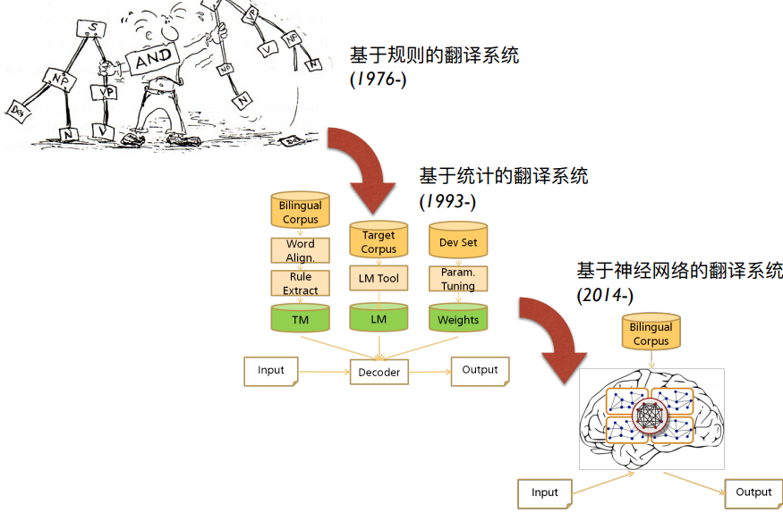
Machine Translation History

Slide 3
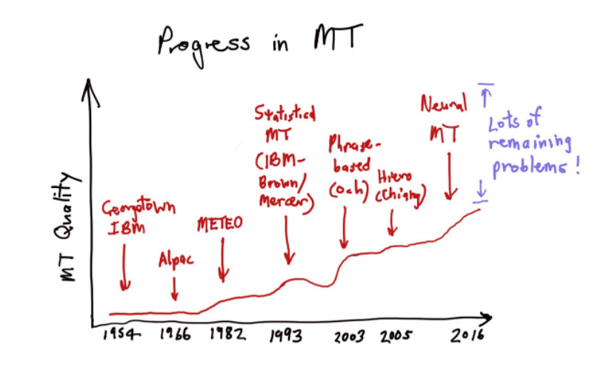
Machine Translation History

Slide 4
Points
Vocabulary Constrain
OOV
Fine-Grained Representation
Decoding Algorithm
Attention Mechanism
External Knowledge
Training Principle
Beam Search
Resource Constrain
No Parallel Data
Few Parallel Data
Architecture Design
RNN->CNN->SAN
Local Encoding

Slide 5
Motivation & Contribution
Why we need UMT:
Current machine translation (MT) systems require access to a considerable volume of translated text.
How to do UMT:
Word-by-word translation->Translating sentences
Achievement:
Equivalent to supervised approaches trained with nearly 100,000 reference translations.
Improvement of more than 10 BLEU points compared with previous UMT model.
For low-resource languages, there is now a way to learn to translate

Slide 6
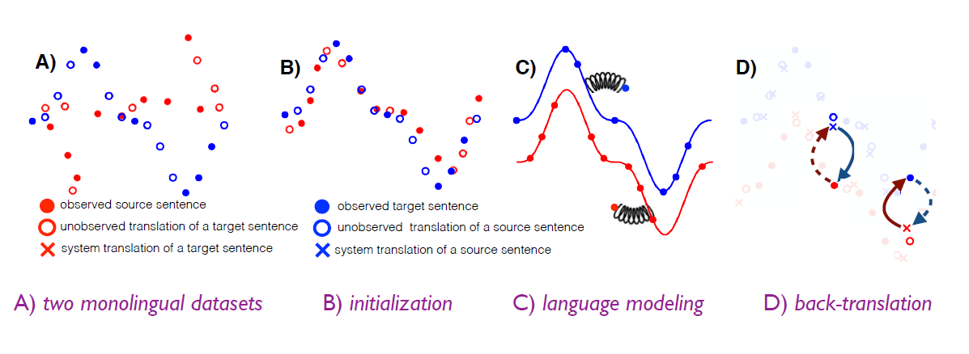
Three principles of unsupervised MT

Slide 7
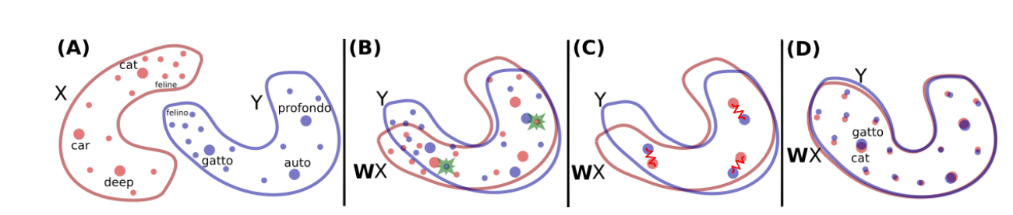
Word-by-word translation
Two-dimensional word embeddings in two languages (left) can be aligned via a simple rotation (right). After the rotation, word translation is performed via nearest neighbor search.
Notes:
1. For instance, the nearest neighbor of “kitty” is “cat,” and the embedding of the word “kitty” is much closer to the embedding of “animal” than it is to the embedding of the word “rocket”
2.embeddings of words in different languages share similar neighborhood structur

Slide 8
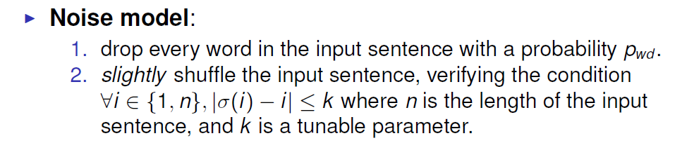
Denoising Auto-Encoder for LM
Without any constraint, the auto-encoder very quickly learns to merely copy every input word one by one.

Slide 9
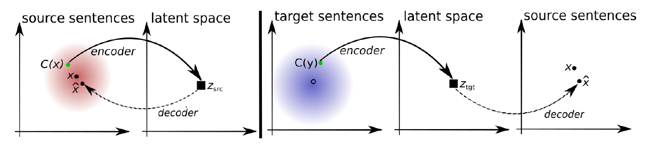
Back Translation

Slide 10
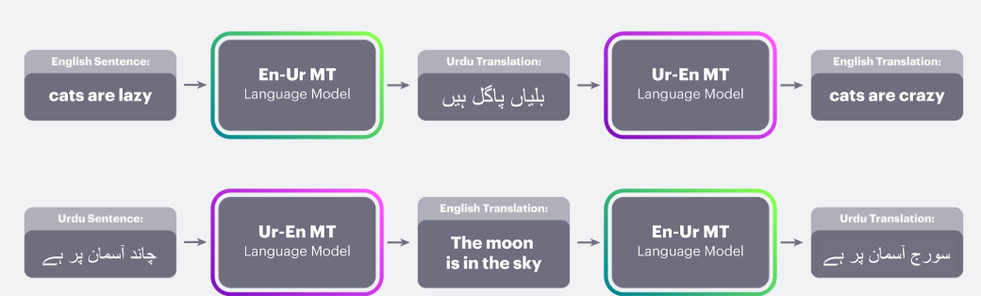
Back Translation

Slide 11
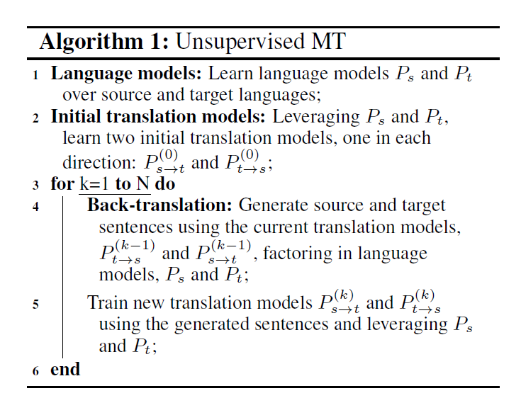
Unsupervised MT Pipeline

Slide 12
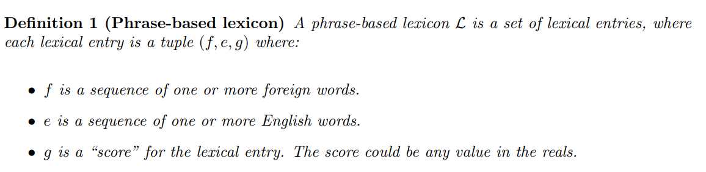
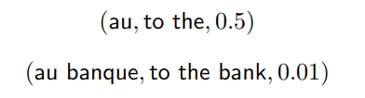


Phrase-Based Translation Models
phrase tables/translation model

Slide 13
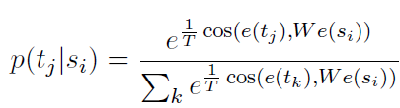
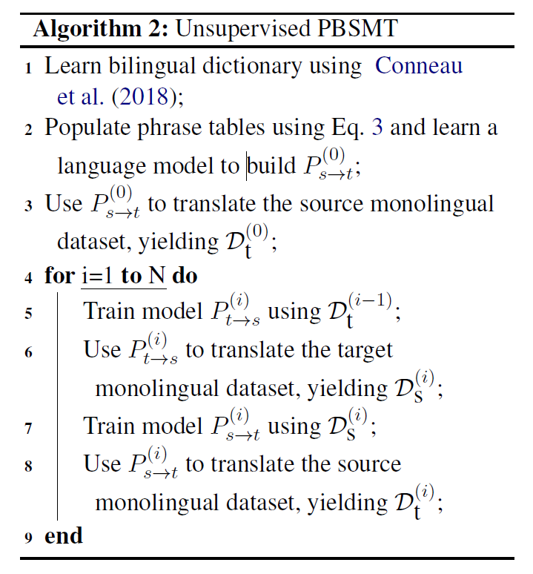
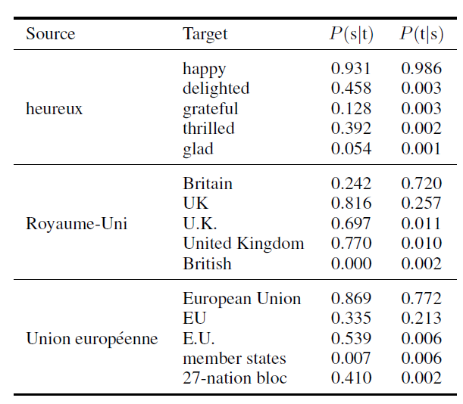
PBSMT Pipeline
Notes:
Table 1 shows an extract of a French-English unsupervised phrase table, where we can see that unigrams are correctly aligned to bigrams, and vice versa.

Slide 14
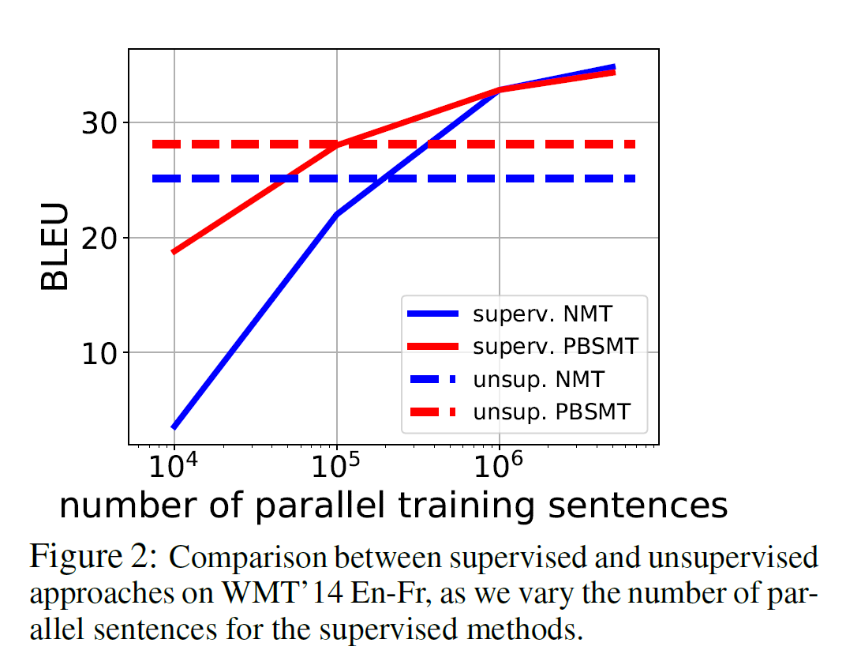
Comparison with Supervised Model

Slide 15
Combination
Unsupervised Neural Model: More fluent than word-by-word translations but did not produce translations of the quality we wanted.
Phrase-Based MT: Produced more correct words but were less fluent.
Combined both models: both fluent and good at translating.
Start from a trained neural model and then train it with additional back-translated sentences from the phrase-based mode.

Slide 16
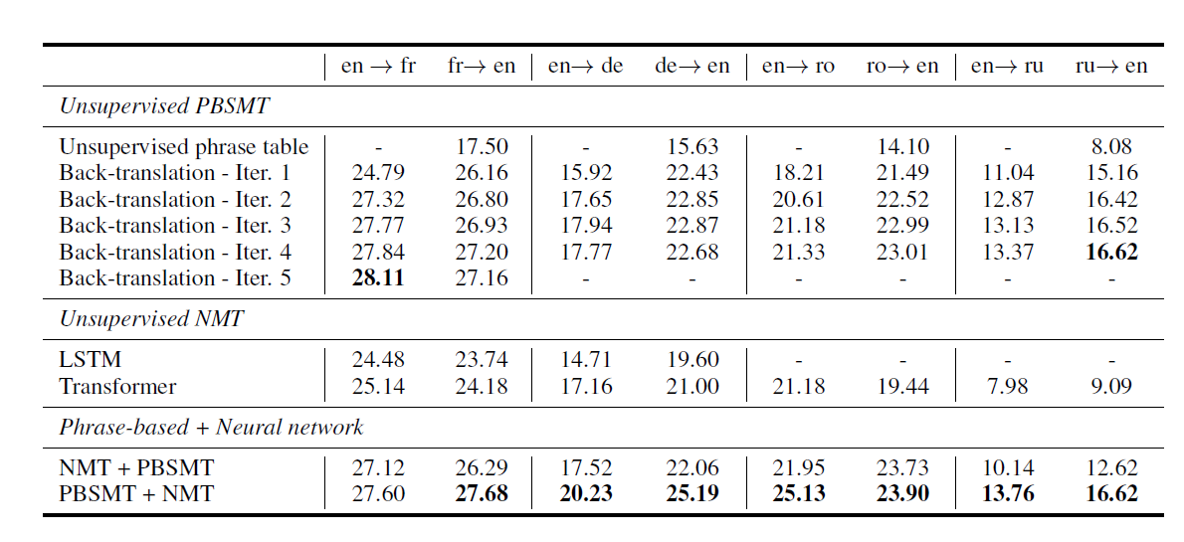
Fully Unsupervised Results

Slide 17
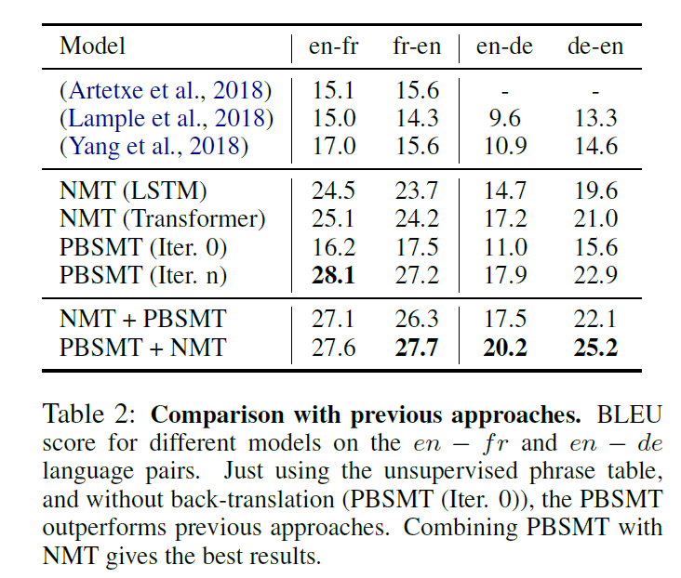
Comparison with Previous UMT Model

Slide 18
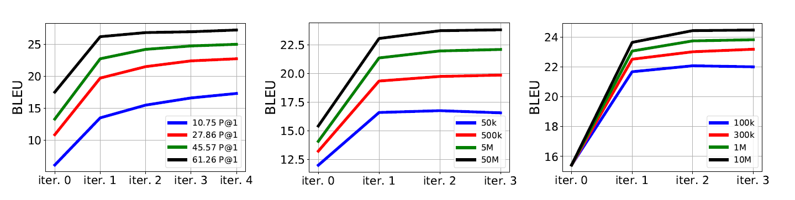
Ablation Study: PBSMT on fr->en
1. The quality of the initial alignment between the source and target embeddings.
2. #sentences used to train the language models.
3. #sentences used for back-translation.

Slide 19
Reference
<Word Translation Without Parallel Data> ICLR 2018
<Unsupervised Machine Translation Using Monolingual Corpora Only> ICLR 2018
<Understanding Back-Translation at Scale> EMNLP 2018
<Phrase-Based & Neural Unsupervised Machine Translation> EMNLP 2018 (Best Long Paper Award)
<Phrase-Based Translation Models> http://www.cs.columbia.edu/~mcollins/pb.pdf

